Slide 1
HTML Intro
<html>
<head>
<title>Web page title vit</title>
</head>
<body>
<h1>Write Your First Heading vit</h1>
<p>Write Your First Paragraph.</p>
</body>
</html>

Slide 2
HTML Format
<html>
<head>
<title>formatting elements</title>
</head>
<body>
<h1>Explanation of italic formatting element</h1>
<p><em>This is an important content</em>, which displayed in italic font.</p>
</body>
</html>

Slide 3
HTML Format
<html>
<head>
<title>formatting elements</title>
</head>
<body>
<h1>Explanation of formatting element</h1>
<p><strong>This is an important content</strong>, and this is normal content</p>
</body>
</html>

Slide 4
HTML Format
<html>
<body>
<p> <b>Write Your First Paragraph in bold text.</b></p>
</body>
</html>

Slide 5
HTML tag
<html>
<body>
<p> Paragraph Tag </p>
<h3> Heading Tag </h3>
<b> Bold Tag </b>
<i> Italic Tag </i>
<u> Underline Tag</u>
</body>
</html>

Slide 6
HTML tag
<html>
<head>
<title>Sub Tag</title>
<style>
body{
text-align: center;
}
p{
color: green;
}
</style>
</head>
<body>
<h2>Example of sub tag</h2>
<p>The chemical formula for Sulphuric acid is: H<sub>2</sub>SO<sub>4</sub></p>
</body>
</html>

Slide 7
HTML Style
<html>
<body>
<h3 style="color:green">This is Green Color</h3>
<h3 style="color:red">This is Red Color</h3>
</body>
</html>

Slide 8
HTML Style
<html>
<body>
<h3 style="background-color:yellow;">This is yellow background</h3>
<h3 style="background-color:red;color:white">This is red background</h3>
</body>
</html>

Slide 9
HTML Style
<html>
<body>
<h3 style="font-family:times new roman">This is times new roman font family</h3>
<p style="font-family:arial">This is arial font family</p>
</body>
</html>

Slide 10
HTML style
<html>
<body>
<h3 style="font-size:200%">This is 200% h3 tag</h3>
<p style="font-size:400%">This is 200% p tag</p>
</body>
</html>

Slide 11
HTML style
<html>
<body>
<h3 style="text-align:right;background-color:pink;">This tag is located at right side</h3>
<p style="text-align:center;background-color:pink;">This tag is located at center side</p>
</body>
</html>

Slide 12
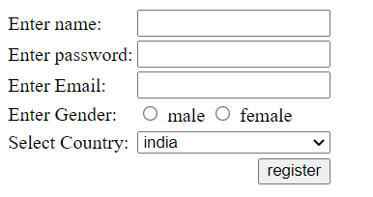
Design a HTML Registration form

Slide 13
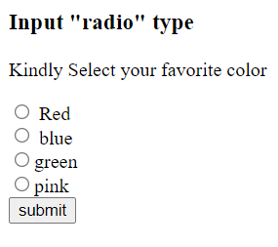

Slide 14
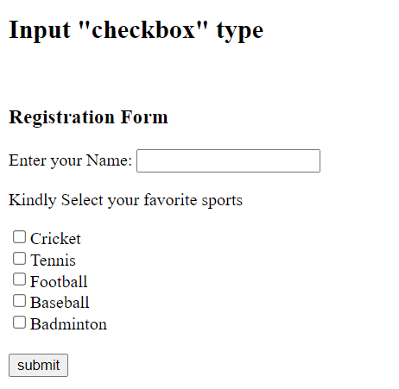

Slide 15
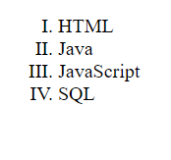
Display list in roman number lowercase.

Slide 16
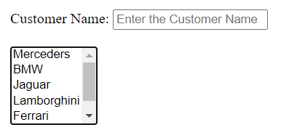
Example that creates a simple list box.

